Slide 1
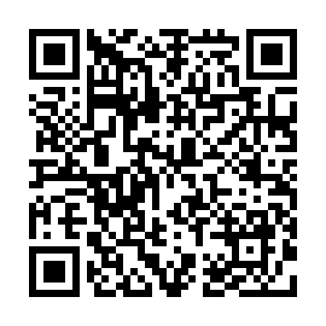
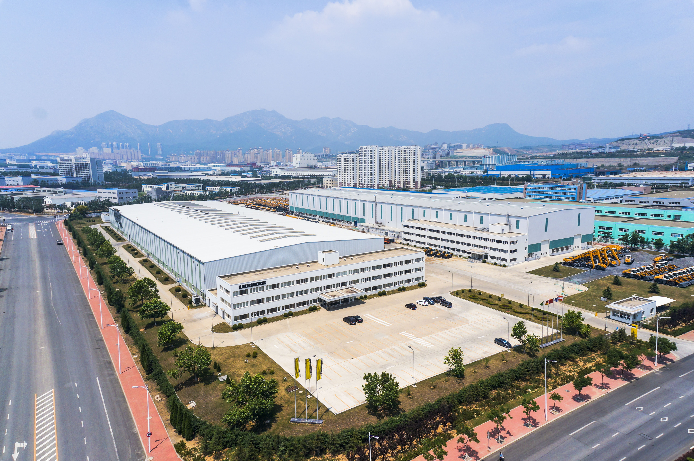
LMD仓库内部物流
信息共享平台
右侧扫码进入数据共享网站
或复制下面网址，粘贴到浏览器
https://littleking1114.netlify.app/
网站信息持续更新中
品质至上
Highest quality in what we do
独立自主
We are independent
勇于担责
We accept responsibility
重视员工
Our employees are a key factor in our success
值得信赖
We are a trustworthy partner
开拓创新
We are innovative

